Slide 1
BIFX 503: Statistics for Bioinformatics
Instructor: Jennifer Schroeder, Ph.D.
Wednesdays, 5:30-8:00pm
Hodson Technology Center, Room 237
Fall 2021

Slide 2
Simultaneous Inference and Multiple Comparisons

Slide 3
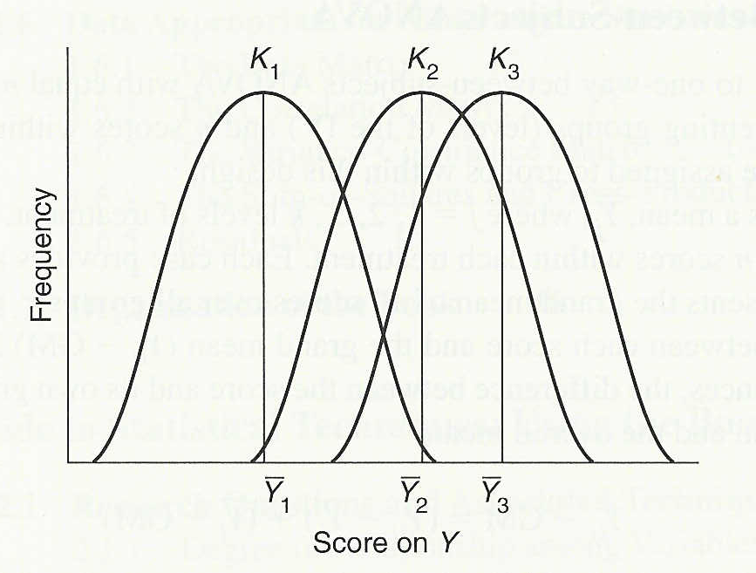
Analysis of Variance (ANOVA)
Used to compare two or more group means to see if there are any reliable differences between them
The null hypothesis is that each of the means comes from the same sampling distribution (i.e. group differences are due to random error)
Figure from Barbara Tabachnick & Linda Fidell’s Using Multivariate Statistics, 4th ed. (Allyn & Bacon, 2001) page 35.

Slide 4
Hypotheses
Null and Alternative
H₀: means are all equal
E.g., H₀: μ₁ = μ₂ = μ₃
H_{A}: means are not all equal
This is the omnibus F test
Tells you if there is a reliable difference among means
Doesn’t tell you which means differ from which other means

Slide 5
Post-Hoc Testing
Step One: do ANOVA to see if a difference in means exists
If you don’t find a difference, you’re done
If you do find a difference, you do more tests to see which means are different
Step Two: Post-Hoc means comparisons
A series of pairwise tests to see which pairs of means differ from one another, e.g.:
Compare the means of Group A with Group B, Group B with Group C, Group A with Group C, ….

Slide 6
Number of Comparisons
If you have a Group variable with 3 levels and want to compare all pairs of means, this amounts to 6 comparisons
Combination formula
n objects taken x at a time
_{n}C_{x} = _{n}P_{x}/x! = n!/(x!*(n-x)!)
3 objects taken 2 at a time = 3!/(2!1!) = 3
4 objects taken 2 at a time = 4!/(2!2!) = 6
6 objects taken 2 at a time = 6!/(2!4!) = 15

Slide 7
Controlling Alpha
The more tests you do, the more likely you are to get a significant result purely by chance
In order to guard against this, you set a more stringent standard for statistical significance for each test
Higher “burden of proof” to offset the increased likelihood of a chance association
Lower alpha for individual tests so that the overall alpha is still low (e.g. <0.05)

Slide 8
Hypothesis Tests as a Function of Groups

Slide 9
Probability of Incorrectly Rejecting H₀ as a Function of Tests Performed

Slide 10
Number of Comparisons
The number of comparisons increases quickly as the number of levels of the group variable increases
Strategy for controlling alpha is to limit the number of pairwise comparisons
More focused set of comparisons than all possible pairs
Sequential (“step-down”) testing procedure
Limit comparisons as each treatment vs control

Slide 11
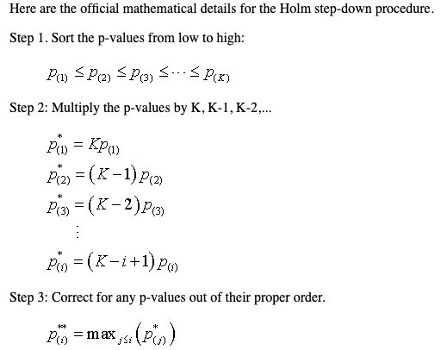
Single Step vs. Sequential
Single step
All possible hypotheses are tested
Sequential – “step down” approach

Slide 12
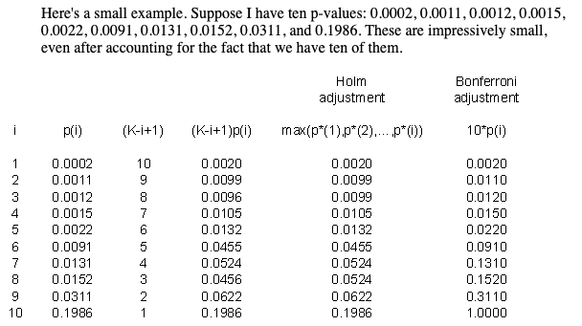
Testing stops when you reach your first non-significant test.
Source: http://www.pmean.com/05/MultipleComparisons.asp

Slide 13
Multiple Comparisons

Slide 14
Multiple Comparisons
Multiple comparisons can inflate alpha for reasons we’ve previously discussed
The more tests you do, the more likely you are to get a significant result purely by chance
Multiple comparisons procedures have alpha control built in
Maintains an overall alpha of 0.05 for all comparisons
This is called the Family-wise Error Rate (FWER)

Slide 15
FWER vs. FDR
Family-wise Error Rate (FWER)
Limits the probability of at least one false discovery (type I error)
False Discovery Rate (FDR)
Sets limits on the expected proportion of false discoveries

Slide 16
FWER vs. FDR
Family-wise Error Rate (FWER)
More stringent control of alpha
False Discovery Rate (FDR)
Greater power
Increased type I errors

Slide 17
Many Multiple Comparisons Procedures Exist!
Tukey HSD
Bonferroni
Holm
Hochberg
Hommel
Benjamini-Hochberg (BH)
Benjamini-Yekutieli (BY)
False Discovery Rate (FDR)
… and many others …..

Slide 18
Tukey’s HSD
Tukey’s Honestly Significant Difference
A.k.a. Studentized Range Test
Creates a set of confidence intervals on the differences between means
Intervals based on the studentized range statistic
Best for balanced designs
Same number of observations per group
Tests all possible pairs of means

Slide 19
Bonferroni
Easiest to implement
If you are doing k tests, the significance level is α/k for each test
Most conservative (least powerful)
Provides strong control of the family-wise error rate

Slide 20
Holm, Hochberg, & Hommel
Modifications on the Bonferroni method
Provide strong control of the family-wise error rate
Less conservative than Bonferroni, although just as valid
Based on sequential testing (step-down)

Slide 21
False Discovery Rate
Expected proportion of false discoveries among the rejected hypotheses
Less stringent condition than familywise error rate
More powerful than Holm et al.
BH and BY are variations on FDR
Best used in exploratory research
Allows investigators to identify “candidate positives” which can be further evaluated in a more rigorous follow-up study

Slide 22
Summary Table
 | Alpha Control | Limitations
Tukey’s HSD | FWER = α | Best for balanced designs
Bonferroni | FWER < α | Overly conservative
Holm/Hochberg/Hommel | FWER = α
FDR/BH/BY | FWER > α | Do not strictly control FWER

Slide 23
ANOVA in R
aov(variable ~ group, data)
Variable refers to the variable you want to test
Group defines the different groups
Data is the dataframe the variables are in
summary(aov(variable ~ group, data))
Output for full ANOVA table
Sums of squares, degrees of freedom, F test

Slide 24
Multiple Comparisons in R
TukeyHSD(aov(variable ~ group, data))
For each pair of means, calculates
mean difference
lower and upper confidence bounds
adjusted p value (difference ≠ 0)
plot(TukeyHSD(aov(variable ~ group, data)))
Plot of confidence intervals
Compare to each other, vertical reference line at zero

Slide 25
Multiple Comparisons in R
Pairwise.t.test(data$variable, data$group, p.adjust.method = “method”)
Where “method” is one of the following:
”bonferroni”, “holm”, “hochberg”, “hommel”, “BH”, “BY”, “fdr”
Produces a matrix of p values
One for each pair of means
All possible pairs

Slide 26
Multiple Comparisons in R
multcomp package
More choices in comparison procedures
“many-to-one” comparisons such as Dunnett’s
Compare each treatment to control
Complex designs
Nested effects, correlated observations
Can also do simpler comparisons, e.g. Tukey

Slide 27
Multiple Comparisons in R
multcomp package function glht(model, linfct)
model is output from aov()
linfct is a contrast matrix specifying the hypotheses to be tested
Instead of all pairwise comparisons we want to compare group A with each other group (B and C)
Coefficients in each row must sum to 0
Groups excluded are zero:
xA xB xC
A-B -1 1 0
A-C -1 0 1

Slide 28
Multiple Comparisons in R
Setting up the contrast matrix
To compare A with B and A with C
K <- rbind(c(-1, 1, 0), c(-1, 0, 1))
Rownames(K) <- c(“A-B”, “A-C”)
Colnames(K) <- names(coef(model))
Resulting matrix:
xA xB xC
A-B -1 1 0
A-C -1 0 1

Slide 29
Example: Chicken Diets
71 newly hatched chicks are randomly assigned to six experimental groups, each group is given a different feed supplement
Chick weights (g) assessed after six weeks
Are weights the same for the six feed supplements?
Hypotheses
H₀: μ₁ = μ₂ = μ₃ = μ₄ = μ₅ = μ₆
H₁: The mean weights of chicks on the six diets are not all equal

Slide 30
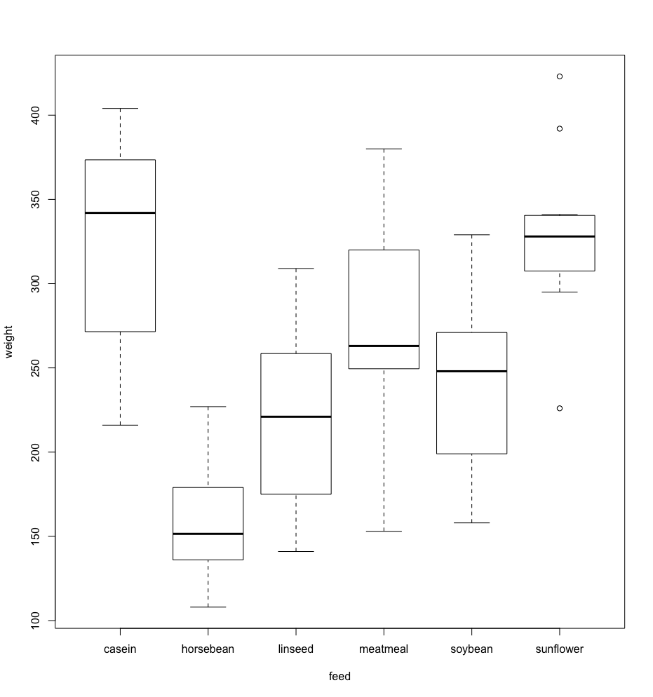

Slide 31
Example: Chicken Diets
71 chicks are randomly assigned to six experimental groups, each group is fed a different diet
Are chick weights (g) the same for the six diets?
ANOVA → Chick weights vary by diet (p<0.0001)
Perform pairwise comparisons to see how the diets differ

Slide 32
Example: Chicken Diets
Method | # | Significant differences
Tukey HSD | 8 | Casein and: horsebean, linseed, and soybean Horsebean and: meatmeal, soybean, and sunflower Sunflower and linseed, soybean
Bonferroni | 8 | Casein and: horsebean, linseed, and soybean Horsebean and: meatmeal, soybean, and sunflower Sunflower and: linseed, soybean
Holm | 8 | Casein and: horsebean, linseed, and soybean Horsebean and: meatmeal, soybean, and sunflower Sunflower and: linseed, soybean
FDR | 11 | Casein and: horsebean, linseed, and soybean Horsebean and: linseed, meatmeal, soybean, and sunflower Sunflower and: linseed, soybean Meatmeal and: linseed, sunflower

Slide 33
Example: Chicken Diets
Suppose you want to compare casein to all other feed types (Dunnett’s)
Specify K:
chicks <- aov(weight ~ feed – 1, chickwts)
summary(glht(chicks, K))
cas hor lin mea soy sun
Casein-horsebean -1 1 0 0 0 0
Casein-linseed -1 0 1 0 0 0
Casein-meatmeal -1 0 0 -1 0 0
Casein-soybean -1 0 0 0 -1 0
Casein-sunflower -1 0 0 0 0 1

Slide 34
Multiple Testing in Bioinformatics
The post-hoc multiple testing that follows a significant ANOVA result is commonly used in experimental science
In bioinformatics, multiple testing procedures are often applied on a much larger scale
Studies involving microarrays or RNA-seq
Thousand or tens of thousands of tests
The following paper is intended to introduce you to multiple testing in this context

Slide 35
Large Scale Multiple Testing

Slide 36
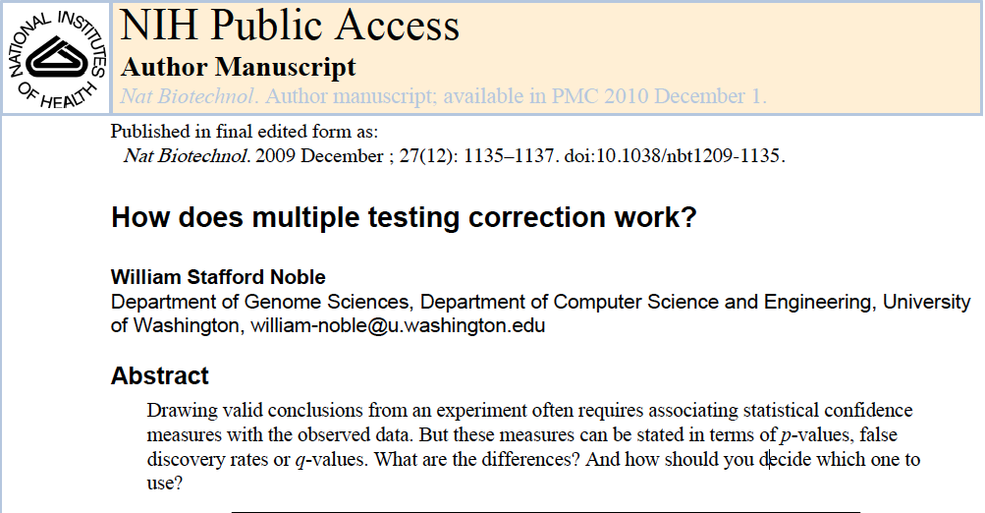
Large Scale Multiple Testing

Slide 37
Large Scale Multiple Testing
Hypothetical proteomics experiment:
Identify proteins involved in a biological process
Successfully identifies most of the proteins you know to be involved in the process, plus a few more
Each novel candidate will need to be verified in a follow-up assay
How do you decide how many candidates to pursue?
Cost-benefit tradeoff
Cost of a false positive
Benefit of identifying a novel protein

Slide 38
Large Scale Multiple Testing
Suppose you are studying CTCF
Zinc finger protein
You want to identify candidate CTCF binding sites in human chromosome 21
You compute a score for each length-20 subsequence of chromosome 21
There are 68 million such subsequences
How likely are high-scoring occurrences of the CTCF binding motif to happen by chance?

Slide 39
Large Scale Multiple Testing
If only one length-20 sequence had been examined, the answer would be a p-value
But there were 68 million tests
Using Bonferroni adjustment
Significance requires p<0.05/68x10⁶ or 7.35x10⁻¹⁰
FWER: we can be 95% sure that none of the scores would be observed by chance if H₀ is true
Overly conservative

Slide 40
False Discovery Rate (FDR)
In large-scale multiple testing, strict control of FWER is often too strict
Expected proportion of false discoveries among the rejected hypotheses
Procedure (Benjamini-Hochberg):
Sort p values in ascending order
Divide each observed p value by its percentile rank
Small p values result in small FDR estimates
Variations on FDR have been developed to overcome its limitations
Q-value (Storey 2002) - an analog of the p-value that incorporates FDR-based multiple testing correction

